Slide 1

PRESENTATION OF THE ROAD SECTOR
THE PERSPECTIVE
Presentation by Min. Calice YAPO, Deputy Managing Director of AGEROUTE
OCTOBER 2018

Slide 2
THE OUTLINE
Presentation of COTE D’IVOIRE
Institutional framework of the road sector
Presentation of AGEROUTE
Some achievements
Economic And Social Challenges Of Ivorian Road Network
Financial needs for Development and Maintenance of the Network.
Strategy For The Development And Safeguarding Of Road Inheritance
Market Opportunities
Upcoming projects
Funding Method
Our Expectations

Slide 3
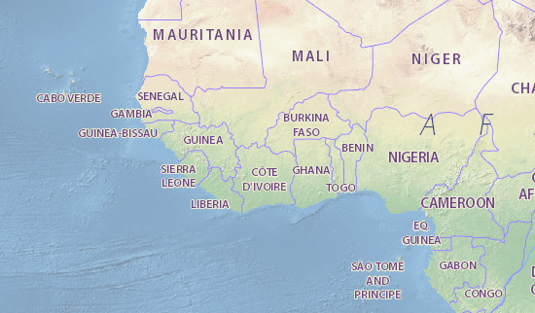
1- PRESENTATION OF CÔTE D'IVOIRE

Slide 4
1- PRESENTATION OF CÔTE D'IVOIRE
Area of the land : 322,462 km²
Côte d'Ivoire shares borders with :
  North West : Mali (532 km) and in the North East: Burkina-Faso (584 km)
  West : Liberia (716 km) and Guinea Conakry (610 km)
  East : Ghana (610 km)
  South : Atlantic Ocean (520 km)
Ivorian population : 23.2 million inhabitants
Official Language : French
Political Capital : Yamoussoukro; Economic Capital: Abidjan
GDP growth rate : 10.3% (2016)
GDP per capital : 816 (in thousands of FCFA /2016)
Annual inflation rate : 1.2% (2016)

Slide 5
1- PRESENTATION OF CÔTE D'IVOIRE
World’s largest cocoa producer (40% of the world production)
World’s largest cashew nut producer
World’s third coffee producer
Africa’s largest palm oil producer
Africa’s largest rubber producer
Africa’s largest banana producer
2 main port cities: Abidjan et San Pedro
International airport: Abidjan (over 1.5 million passengers a year)
The agricultural income represents about 34% of the GDP and generates about 68% of export earnings

Slide 6
2- INSTITUTIONAL FRAMEWORK OF THE ROAD SECTOR
Funding
State
The Road Maintenance Fund
(FER in french)
Government
Road management Agency
(AGEROUTE in french)
PRIVATE SECTOR
Ministry of Equipment
Road Maintenance
(MEER in french)
(Studies office, SME, materials renting company, etc…)
Cell of support to small and medium entreprises (SME)
Materials et logistics means
project management of works
Implementation of works
Delegated contracting authority and project management
(monitoring of work)
Contracting authority

Slide 7
3- PRESENTATION OF AGEROUTE
AGEROUTE: Road Management Agency
State corporation created by decree N ° 2001-592 of September 19, 2001
It has been operational since February 2003
The current workforce is made up of 134 people
The missions of AGEROUTE:
Preparation and Execution of Programming Tasks
Markets Procurement
Monitoring of works
Monitoring of the national network
Establishment and operation of Road Data Banks (RDB)
Capacity building (SMEs and AGEROUTE)

Slide 8
4 - SOME ACHIEVEMENTS
Major structuring projects completed and inaugurated:
Bridges: Henri Konan Bédié, Bouaflé, Phillipe YACE of Jacqueville, Béoumi , Bassawa, etc…
Highways: Gesco – Singrobo 140 Km reinforced, Singrobo-Yamoussoukro 86 Km built, Abidjan-Grand-Bassam 28 km built.
Roads: Boundiali – Tengréla-Border Mali 135 km, Comoé-Abengourou-Agnibilékro 87,5 km built. Many other projects including urban roads and intercity roads rehabilitated. More than 15,000 km of rural roads have been re profiled.

Slide 9
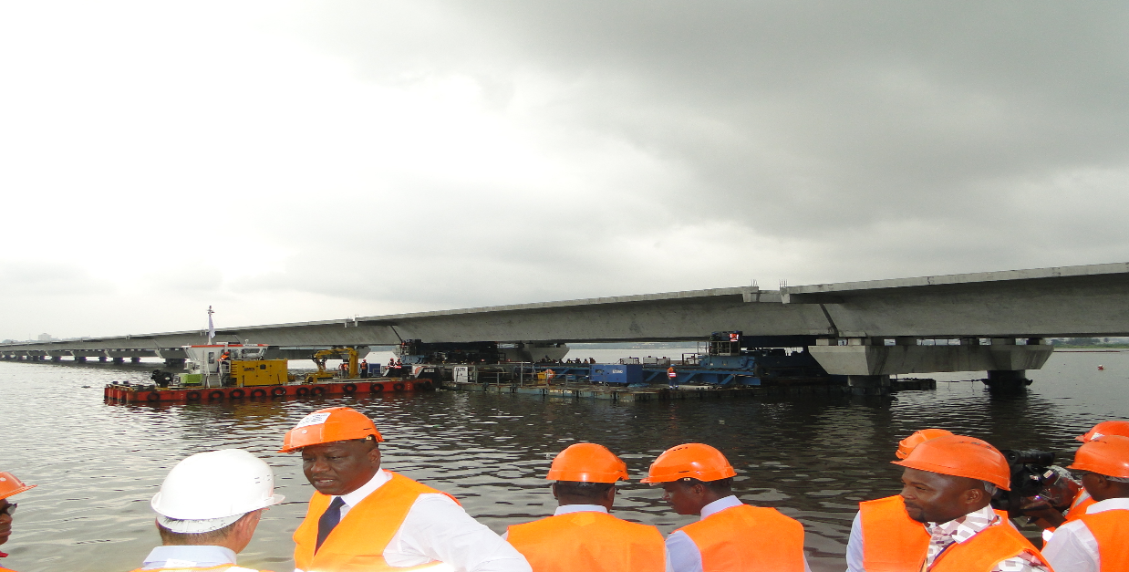
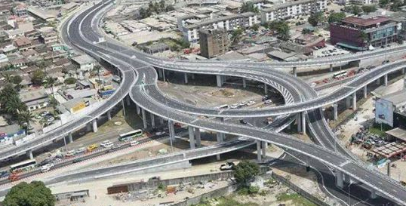
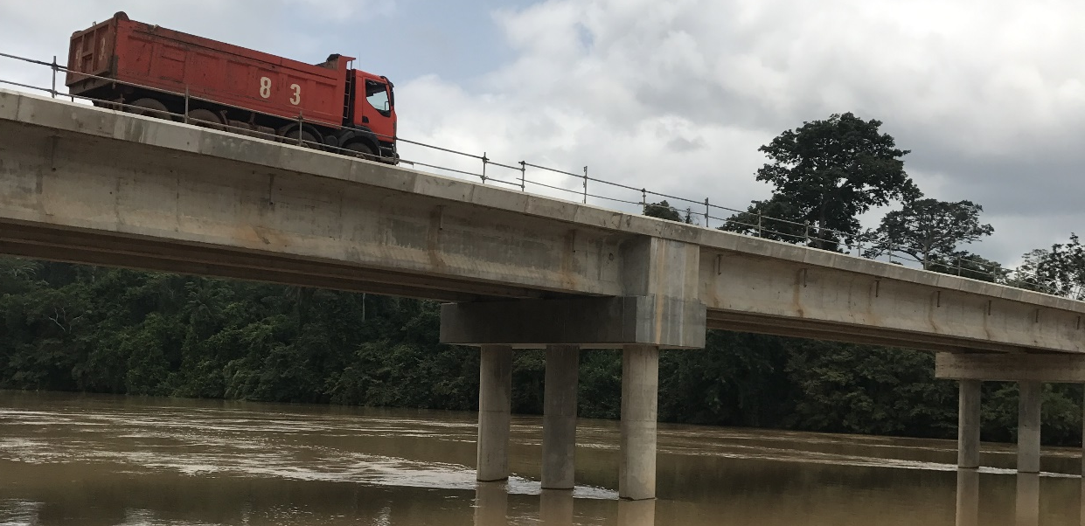
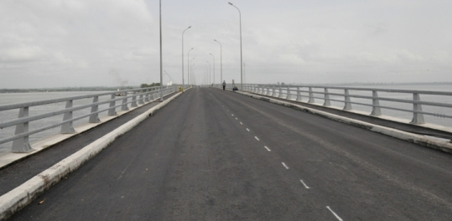
4 - SOME ACHIEVEMENTS
HKB BRIDGE
VGE BOULEVARD INTERCHANGE
BETTIE BRIDGE
PHILIPPE YACE BRIDGE OF JACQUEVILLE

Slide 10
5- ECONOMIC AND SOCIAL CHALLENGES
The Ivorian roads:
Transport almost 90% of people and goods;
Link agricultural areas
Fight against poverty and improve the living environment of the population ;
Contribute to the emergence of regional clusters ;
Facilitate regional integration.

Slide 11
6- FINANCIAL NEEDS FOR DEVELOPMENT AND MAINTENANCE OF THE NETWORK
1 Objective 2020
 | Linear to be added (km) | Cost (CFA) Billions | Cost (euro) Millions
New roads | 1,897 | 1,106 | 1,690
Rehabilitation | 1,185 | 356 | 541
Highways | 200 | 4 11 | 627
Bridges | 100 | 500 | 762
Small bridges | 400 | 80 | 122
Total Cost: 2,456 Billion CFA (3,742 Million Euro)

Slide 12
6- FINANCIAL NEEDS FOR DEVELOPMENT AND MAINTENANCE
OF THE NETWORK
2 Objective 2035
 | Linear to be added (km) | Cost (CFA) Billions | Cost (Euro) Millions
New roads | 3,250 | 1,950 | 2,970
Rehabilitation | 6,000 | 1,800 | 2,745
Highways | 1,800 | 3,600 | 5,490
Bridges | 200 | 1,000 | 1,524
Small bridges | 1,000 | 200 | 305
Total Cost : 8,550 Billion CFA (13,034 Million Euro)

Slide 13
7- STRATEGY FOR THE DEVELOPMENT AND SAFEGUARDING OF THE ROAD INHERITANCE
THE OBJECTIVES OF THE GOVERNMENT IS TO:
give priority to the routine and periodic maintenance program to safeguard the Ivorian road assets
optimize the existing road network by building new roads
promote good governance in the road sector and fight poverty at the national level specially in the rural area

Slide 14
7- STRATEGY FOR THE DEVELOPMENT AND SAFEGUARDING OF THE ROAD HERITAGE
Strengthening the capacities of structures (AGEROUTE & FER);
Identification and prioritization of infrastructure needs to be registered with the NDP :
Development of the network (infrastructure development master plan that prioritizes interventions),
Safeguarding of road assets (road maintenance strategy, 305 million EUR emergency program since 2011);
Implementation of funding strategies.
A more attractive frame-work for investment;
A coherent development of road infrastructure.
STRATEGY FOR ACHIEVING THESE OBJECTIVES

Slide 15
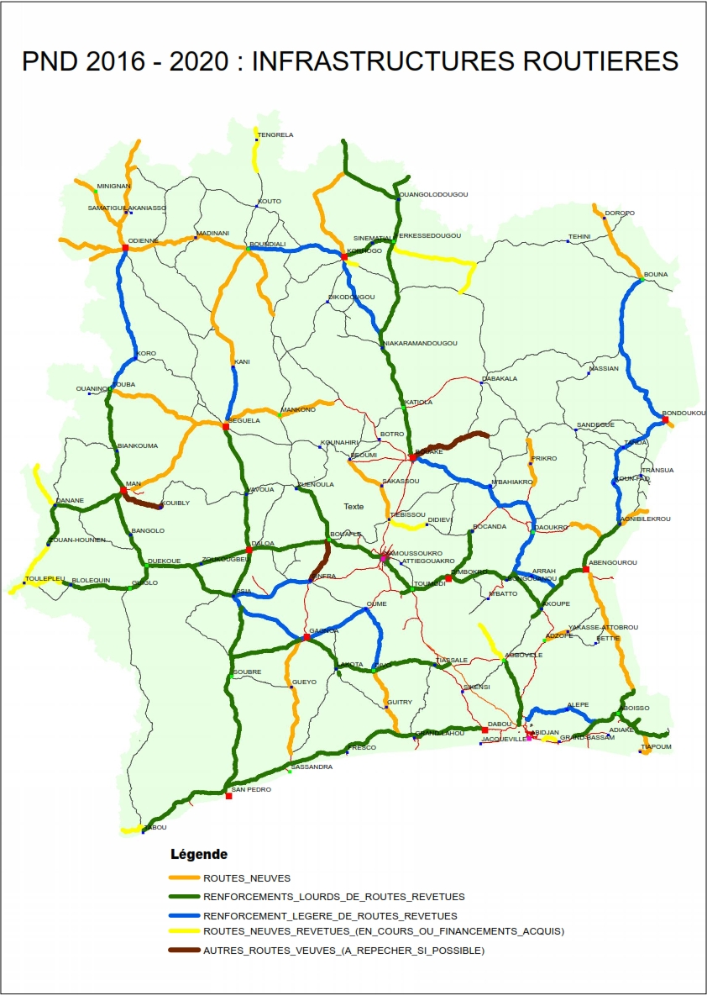
8- MARKET OPPORTUNITIES
PND 2016 – 2025 Route interurbaine
New roads
Ongoing Program:
14 roads
1170 km
491 Billion CFA (748 Million euro)
  Future Program
51 roads
3,582 km
2.043 Billion CFA (3114 Million euro)
Reinforcement
Ongoing Program :
3 itinerary
... 250 km
75 billion CFA (114 Million euro)
  Future Program
20 roads
1500 km
600 billion CFA (914,6 million euro)
Carte PND

Slide 16
8- MARKET OPPORTUNITIES
Abidjan Urban Transport Project (PTUA)
Description of the Infrastructure Component
  Widening of the roads of Dabou (19 km) and the road of civil prison (23 km)
  Development of the bypass Y4 (24.4 km) and extension of the Boulevard Latrille (10.5 km)
  Construction of 3 interchanges on Boulevard François Mitterrand
  Rehabilitation of traffic lights at 90 intersections
  Total cost of the project: 466 Billion of CFA,
Project Implementation Status (Works of the 4th bridge):
  Launch of the call for tender is in progress
  Estimated start date of road works: March 2019

Slide 17
8- MARKET OPPORTUNITIES
I-1-1. Construction of roads in the Midwest: Zouan Hounien - Touleupleu and Séguéla-Mankono
Objective of the project:
Contribute to the economic and social development of the departments of Mankono, Zouan Hounien and Touleupleu as well as the regional integration of Côte d'Ivoire, Guinea and Liberia
Description of project:
Road works :
  Asphalting of the road Toulepleu Zouan-Hounien 45 km
  Asphalting of the Mankono-Séguéla road of 55 km
  Cost of the project
  66 billion FCFA
Project Implementation Status:
Procurement is underway
Estimated start date of works: March 2019

Slide 18
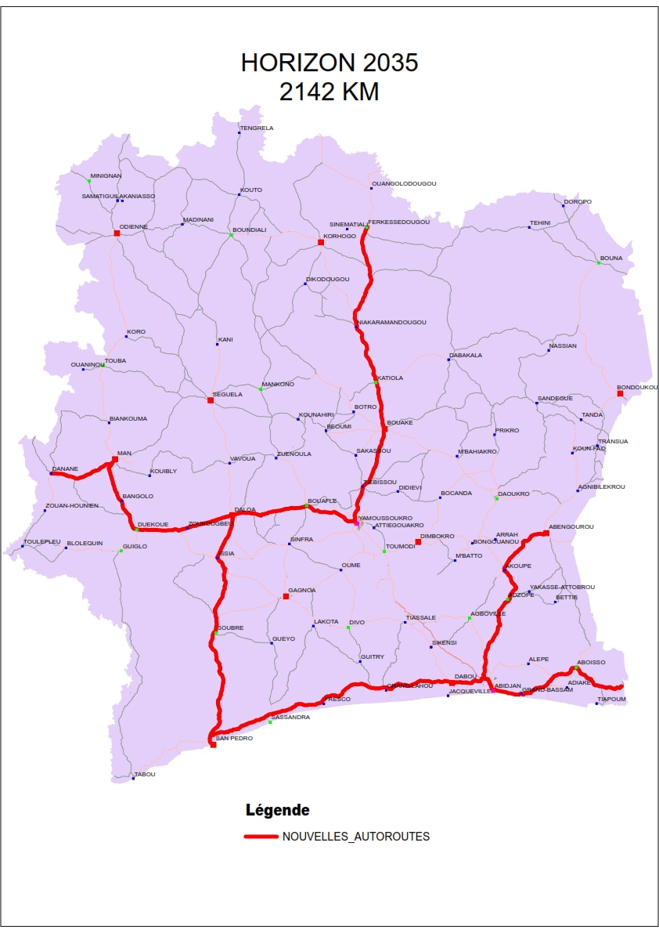
9-UPCOMING PROJECTS
HIGHWAYS, URBAN ROADS AND BRIDGES (2015-2035)
Highways
4 itinerary
2145 km
4290 billion CFA (6600 million euro)
Urban Roads
Road ( 2 x 2 /2x1 ) :
327 km
275 billion CFA (419. millions euro)
  Structuring way
100 km
200 Billion CFA (304 millions euro)
Bridges
4 Interchanges
100 Billion F CFA (152 Million)

Slide 19
9-UPCOMING PROJECTS
9.1- INTER URBAN ROAD PROJECT :
PROJECT | LINEAR (Km) | COST (In billions of CFA francs) | COST (In millions of euros)
Asphalting of the -Bassam Samo highway (2x3 ways) | 30 | 157 | 239.3
Asphalting project of Bouake - Sandégué - Tanda road (2x1 ways) | 278 | 120.1 | 183.1
Strengthening the priority Covered Network ( 2x1 ways) | 1500 | 600 | 914.6
Development of the structuring road of district capitals and regions | 300 | 211 | 321.6
Asphalting of intercity roads throughout the national territory | 2200 | 1215 | 1852.1
Asphalting of the Odienne- Samatiguila- Mali border road and related braces | 192 | 85.5 | 130.3
Asphalting of the Odienne- Minignan- Guinea border road | 75 | 55 | 83.8
Asphalting of the Danane - Gbeunta road | 25 | 13 | 19.8
TOTAL |  | 2456.6 | 3744.6

Slide 20
9-UPCOMING PROJECTS
9.2- URBAN ROAD PROJECT (2x2 ways) :
PROJECT | LINEAR (Km) | COST (In billions of CFA francs) | COST (in millions of euros)
Marseille Boulevard Phase II | 5 | 30 | 45.7
France Boulevard Extension (old road of Bingerville) with variable Central reservation (2 to 4 m) | 7 | 16 | 24.4
V23 (extension of the road from the 4th bridge ) and V28 ( ile bouley/Azito – Crossroads zone )(north-south) | 15 | 18 | 27.4
Development of the crossroad of Williamsville (Djeni Kobenan) |  | 25 | 38.1
Development of bel air -firefighter Crossroad |  | 15 | 22.9
TOTAL |  | 104 | 158.5

Slide 21
9-UPCOMING PROJECTS
9.3- ENGINEERING STRUCTURE PROJECT :
PROJECT | COST (In billions of CFA francs) | COST (In millions of euros)
Construction of Vonkoro engineering structure project on the Black Volta | 11.4 | 17.4
Construction of 3 bridges on the west of Côte d'Ivoire (Man. Guiglo, Tai) | 20.35 | 31
Construction of 113 engineering structures of improving access on the national territory | 286 | 436
Construction of 400 hydraulic structures on the national territory | 58 | 88.4
Construction of the bridge over the Comoé river(Abengourou Adzopé-axis) | 11 | 16.8
TOTAL | 386.75 | 589.6

Slide 22
10- FUNDING METHOD
National Budget
Road Maintenance Fund (FER)
(Fundraising to finance road maintenance)
Technical and Financial Partners.
Concessional or market rate loans
Public-Private Partnerships (PPP)
Special Funds : Coffee-Cocoa Council, etc.

Slide 23
11- OUR EXPECTATIONS
Projects funding at low rate
Design and built or PPP projects
Fundraising for Future Road Development & Maintenance programs

Slide 24
THANK YOU

